Slide 1

Programmatic Execution of SQL
Programmatic access to a database
Executing SQL from Python
Examples: sqlite, MySQL

Slide 2
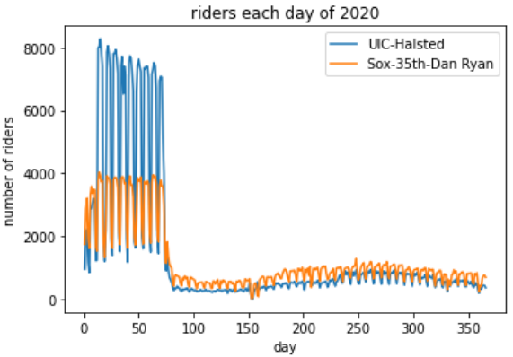
Executing SQL within other languages
SQL is a powerful language, but lacking in other areas
No UI support, no graphics, no web, no mobile
SQL is commonly embedded within other languages
JavaScript
Python
Java
Swift
C#
etc.

Slide 3

Executing SQL from Python
Database server
SELECT * FROM ...;
Database

Slide 4
sqlite3 Python library
import sqlite3
dbConn = sqlite3.connect("filename.db")
dbCursor = dbConn.cursor()
# query to retrieve 1 row from DB:
sql = """
Select …
From …
Where … ;
"""
dbCursor.execute(sql)
row = dbCursor.fetchone()
print(row)
Open connection
Create a cursor
Execute SQL
Fetch result
fetchone( )
Returns a tuple (...)
fetchall( )
Returns a list of tuples
# query to retrieve N values from DB:
sql = """
Select …
From …
Where … ;
"""
dbCursor.execute(sql)
rows = dbCursor.fetchall()
for row in rows:
print(row)

Slide 5
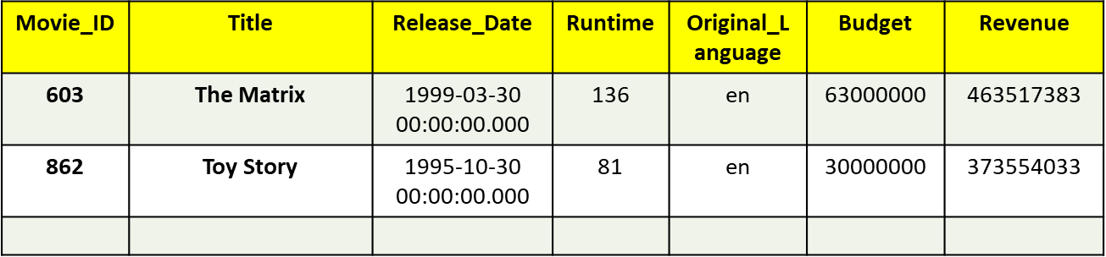
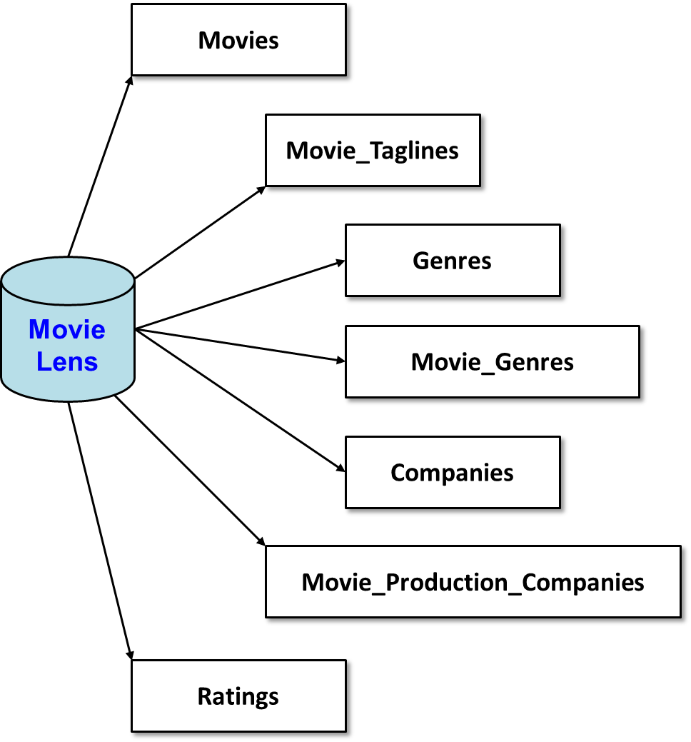
MovieLens database

Slide 6
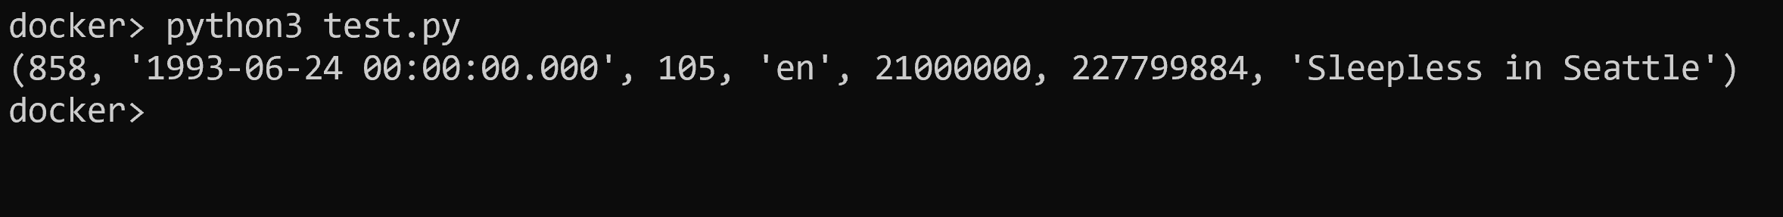
Example
import sqlite3
dbConn = sqlite3.connect("movielens.db")
dbCursor = dbConn.cursor()
sql = """
select * from movies
where title = 'Sleepless in Seattle';
"""
dbCursor.execute(sql)
row = dbCursor.fetchone()
print(row)

Slide 7
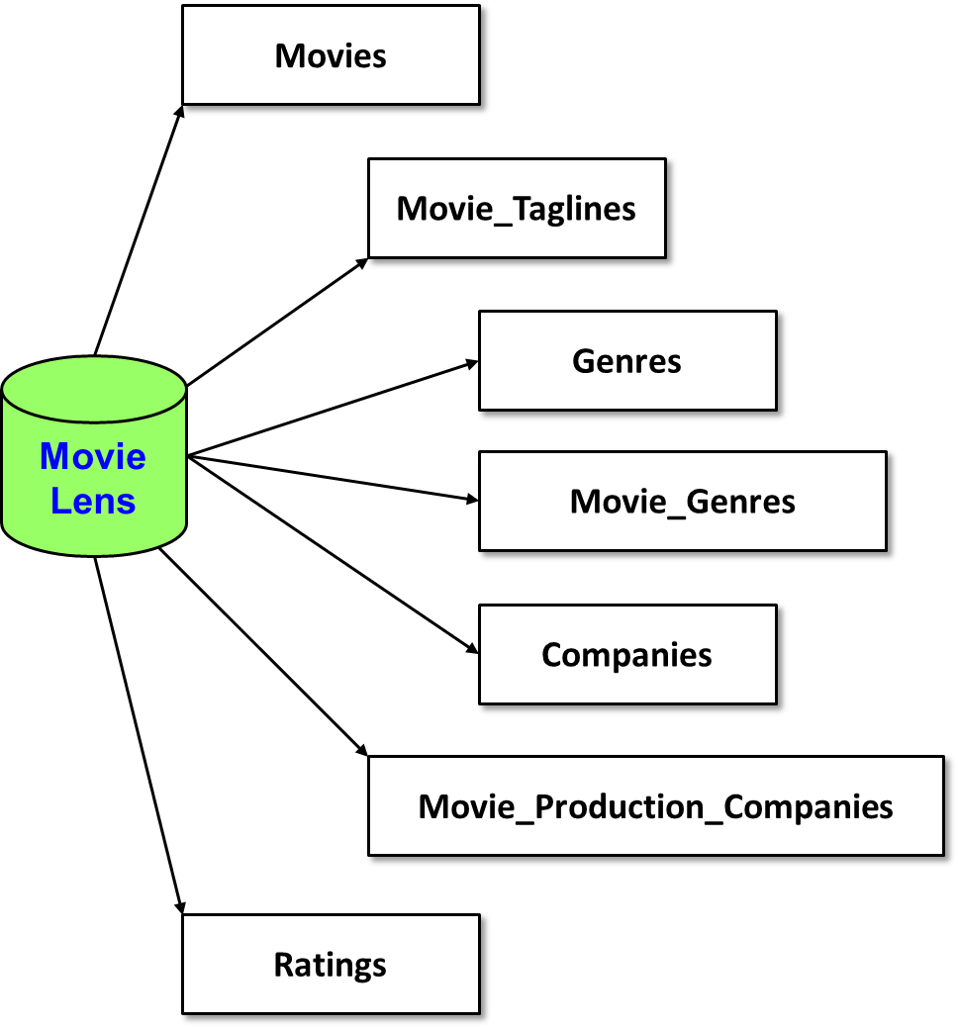
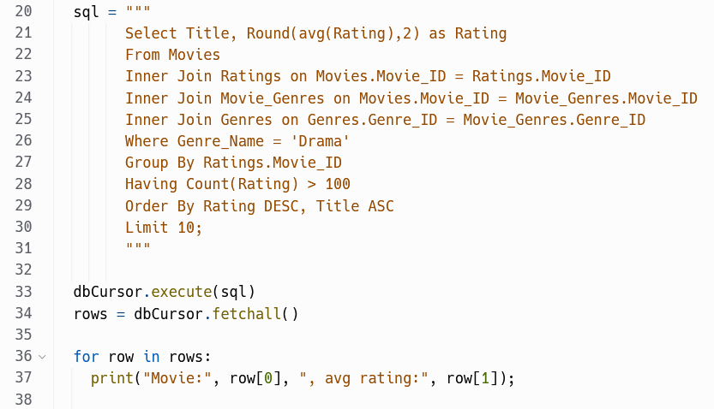
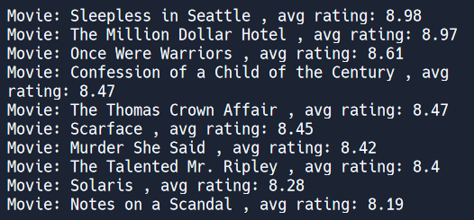
Top-10 movies in Drama genre
Top-10 Drama movies

Slide 8
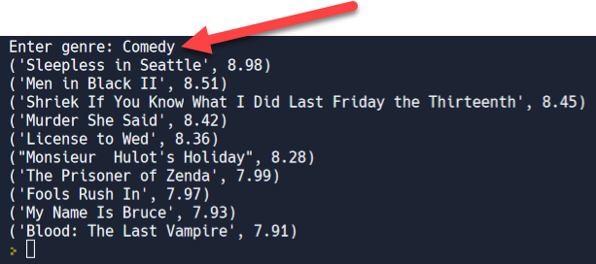
Parameterized (“dynamic”) queries
Most queries are dynamic, responding to user input

Slide 9
Executing dynamic queries
import sqlite3
dbConn = sqlite3.connect("chicago-police-stops.db")
dbCursor = dbConn.cursor()
genre = input("Enter genre: ")
sql = """
Select Title, Round(avg(Rating),2) as Rating
From Movies
Inner Join Ratings on Movies.Movie_ID = Ratings.Movie_ID
Inner Join Movie_Genres on Movies.Movie_ID = Movie_Genres.Movie_ID
Inner Join Genres on Genres.Genre_ID = Movie_Genres.Genre_ID
Where Genre_Name = ?
Group By Movies.Movie_ID
Having Count(Rating) > 100
Order By Rating DESC, Title ASC
Limit 10;
"""
dbCursor.execute(sql, [genre])
rows = dbCursor.fetchall()
for row in rows:
print(row)
placeholder…
NOTE: with MySQL use %s instead of ?
Provide parameter value(s) in call so DBMS builds query and checks for injection attacks

Slide 10

Beware SQL injection attacks
genre = input("Enter genre: ")
sql = "…" + genre + "…"
sql = f"… {genre} …"
dbCursor.execute(sql)
rows = dbCursor.fetchall()
for row in rows:
print(row)
NEVER build sql query strings yourself --- you open the door to SQL injection attacks
https://www.bleepingcomputer.com/news/security/researchers-find-sql-injection-to-bypass-airport-tsa-security-checks/
Notes:
Demo with main-concat.py and enter this input
ignore'; delete from ratings; --

Slide 11


How about executing SQL with MySQL?
Database server
SELECT * FROM ...;
Database

Slide 12
pymysql
Use pymysql module --- nearly identical API !
https://pymysql.readthedocs.io/en/latest/
import pymysql
try:
dbconn = pymysql.connect(
host=ENDPOINT,
port=PORTNUM,
user=USERNAME,
passwd=PASSWORD,
database=DBNAME)
sql = "…"
dbCursor = dbconn.cursor()
dbCursor.execute(sql)
rows = dbCursor.fetchall() # or fetchone()
for row in rows:
print(row)
except Exception as e:
print("Database connection failed due to {}".format(e))
For dynamic queries use %s instead of ?

Slide 13
That's it, thank you!

Slide 14
Movies
Movie_Taglines
Genres
Movie Lens
Movie_Genres
Companies
Movie_Production_Companies
Ratings

Slide 15
Movie_ID | Title | Release_Date | Runtime | Original_Language | Budget | Revenue
603 | The Matrix | 1999-03-30 00:00:00.000 | 136 | en | 63000000 | 463517383
862 | Toy Story | 1995-10-30 00:00:00.000 | 81 | en | 30000000 | 373554033
Movies
Movie_ID | Tagline
603 | Welcome to the Real World.
605 | Everything that has a beginning has an end.
Movie_Taglines
Movie Lens
Ratings
Movie_ID | Rating
605 | 8
603 | 6
605 | 10
605 | 6

Slide 16
Company_ID | Company_Name
1885 | Silver Pictures
6194 | Warner Bros.
Movie_ID | Company_ID
603 | 1885
603 | 6194
862 | 3
Companies
Movie_Production_Companies
Movie_ID | Genre_ID
862 | 16
862 | 35
603 | 28
603 | 878
Movie Lens
Movie_Genres
Genres
Genre_ID | Genre_Name
28 | Action
878 | Science Fiction
16 | Animation
35 | Comedy

